Slide 1
B+-tree and Hash Indexes
B+-trees
Bulk loading
Static Hashing
Extendible Hashing
Linear Hashing

Slide 2
B⁺-Tree Index Files
B⁺-tree indices are an alternative to indexed-sequential files.
Disadvantage of indexed-sequential files: performance degrades as file grows, since many overflow blocks get created. Periodic reorganization of entire file is required.
Advantage of B⁺-tree index files: automatically reorganizes itself with small, local, changes, in the face of insertions and deletions. Reorganization of entire file is not required to maintain performance.
Disadvantage of B⁺-trees: extra insertion and deletion overhead, space overhead.
Advantages of B⁺-trees outweigh disadvantages, and they are used extensively in all commercial products.

Slide 3
B⁺-Tree Index Files (Cont.)
A B⁺-tree is a rooted tree satisfying the following properties:
All paths from root to leaf are of the same length (i.e., balanced tree)
Each node has between ⎡n/2⎤ and n pointers. Each leaf node stores between ⎡(n–1)/2⎤ and n–1 values.
n is called fanout (it corresponds to the maximum number of pointers/children). The value ⎡(n-1)/2⎤ is called order (it corresponds to the minimum number of values).
Special cases:
  If the root is not a leaf, it has at least 2 children.
  If the root is a leaf (that is, there are no other nodes in the tree), it can have between 0 and (n–1) values.

Slide 4
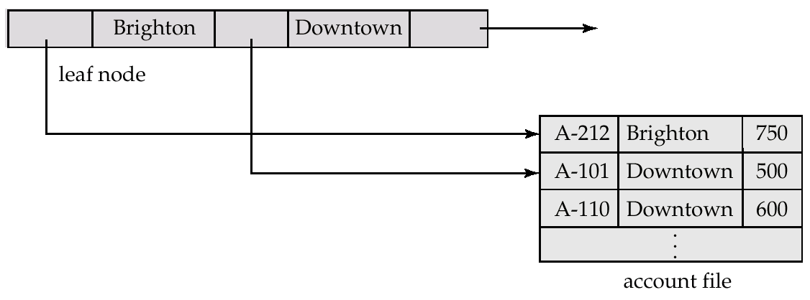
Leaf Nodes in B⁺-Trees
Properties of a leaf node:
For i = 1, 2, . . ., n–1, pointer P_{i} either points to a file record with search-key value K_{i}, or to a bucket of pointers to file records, each record having search-key value K_{i}. If L_{i}, L_{j} are leaf nodes and i < j, L_{i}’s search-key values are less than L_{j}’s search-key values
P_{n} points to next leaf node in search-key order (right sibling node)

Slide 5
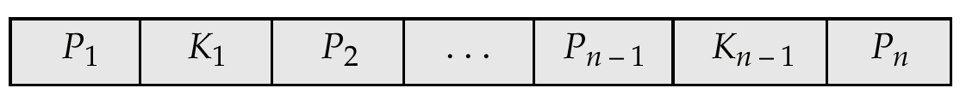
Non-Leaf Nodes in B⁺-Trees
Non leaf nodes form a multi-level sparse index on the leaf nodes. For a non-leaf node with m pointers:
  All the search-keys in the subtree to which P₁ points are less than K₁
  For 2 ≤ i ≤ n – 1, all the search-keys in the subtree to which P_{i} points have values greater than or equal to K_{i–1} and less than K_{i} (example : P₂ points to a node where the value v of each key is K₁ <=v< k₂)

Slide 6
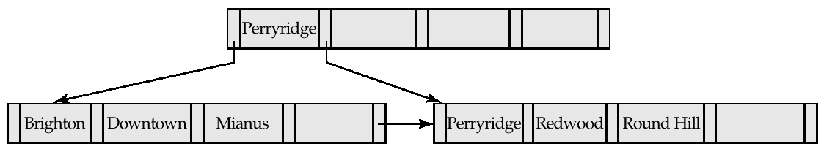
Example of B⁺-tree
B⁺-tree for account file (n = 5)
Leaf nodes must have between 2 and 4 values
(⎡(n–1)/2⎤ and n –1, with n = 5).
Non-leaf nodes other than root must have between 3 and 5 children (⎡(n/2⎤ and n with n =5).
Root must have at least 2 children.

Slide 7
Observations about B⁺-trees
Since the inter-node connections are done by pointers, the close blocks need not be “physically” close (i.e., no need for sequential storage).
The non-leaf levels of the B⁺-tree form a hierarchy of sparse indices.
The B⁺-tree contains a relatively small number of levels (logarithmic in the size of the main file), thus search can be conducted efficiently.
Insertions and deletions to the main file can be handled efficiently, as the index can be restructured in logarithmic time (as we shall see).

Slide 8
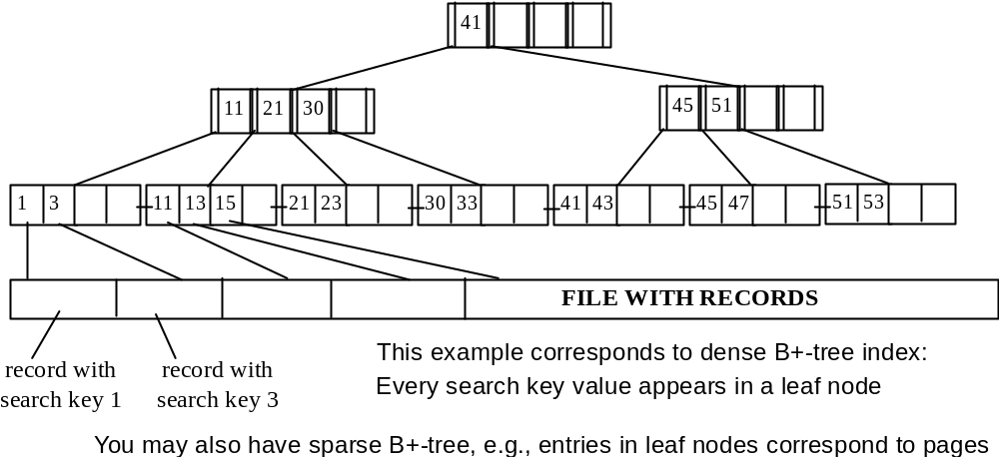
Example of clustering (primary) B+-tree on candidate key

Slide 9
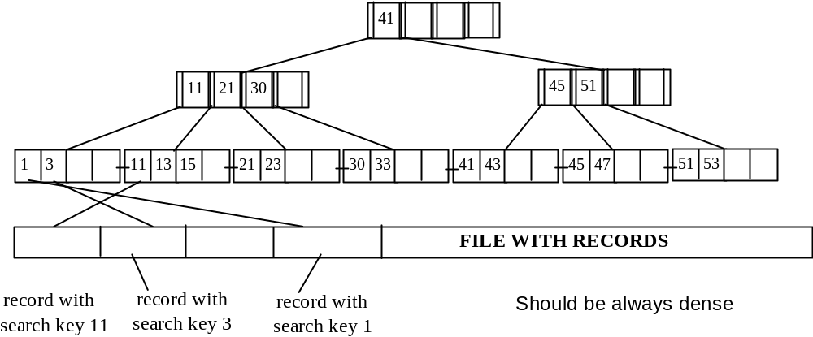
Example of non-clustering (secondary) B+-tree on candidate key

Slide 10
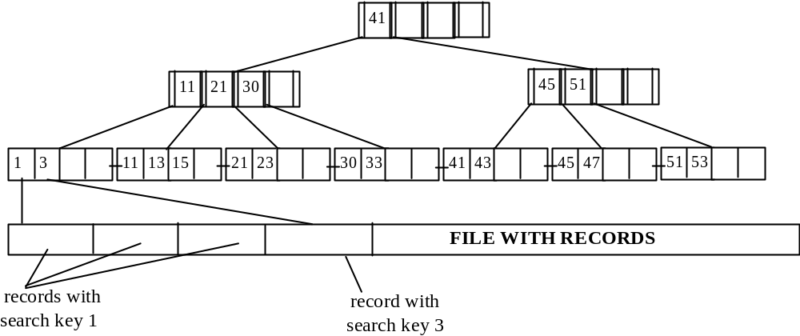
Example of clustering B+-tree on non-candidate key

Slide 11
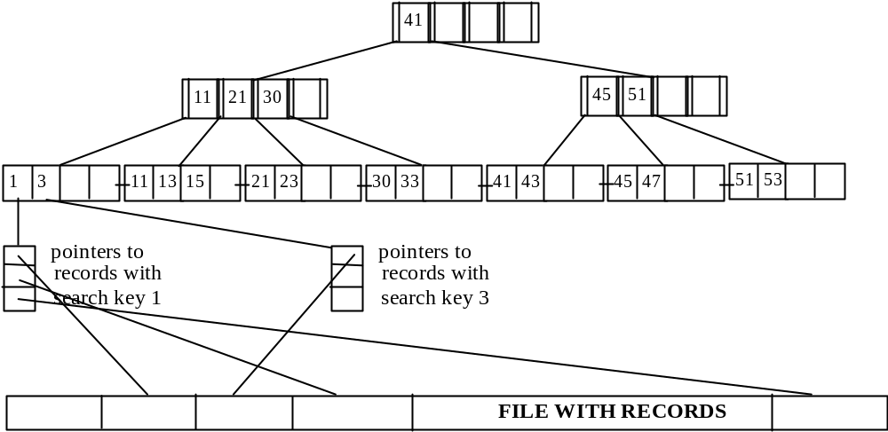
Example of non-clustering B+-tree on non-candidate key

Slide 12
Queries on B⁺-Trees
Find all records with a search-key value of k.
  Start with the root node
    If there is an entry with search-key value K_{j} = k, follow pointer P_{j+1}
    Otherwise, if k < K_{m–1} (there are m pointers in the node, i.e., k is not the larger than all values in the node) follow pointer P_{j}, where K_{j} is the smallest search-key value > k.
    Otherwise, if k ≥ K_{m–1}, follow P_{m} to the child node.
  If the node reached by following the pointer above is not a leaf node, repeat the above procedure on the node, and follow the corresponding pointer.
  Eventually reach a leaf node. If for some i, key K_{i} = k follow pointer P_{i} to the desired record or bucket. Else no record with search-key value k exists.

Slide 13
Queries on B⁺⁻Trees (Cont.)
In processing a query, a path is traversed in the tree from the root to some leaf node.
If there are K search-key values in the file, the path is no longer than ⎡ log_{⎡n/2⎤}(K)⎤.
A node is generally the same size as a disk block, typically 4 kilobytes, and n is typically around 100 (40 bytes per index entry).
With 1 million search key values and n = 100, at most
log₅₀(1,000,000) = 4 nodes are accessed in a lookup.

Slide 14
Inserting a Data Entry into a B+ Tree
Find correct leaf L.
Put data entry onto L.
  If L has enough space, done!
  Else, must split L (into L and a new node L2)
    Redistribute entries evenly, copy up middle key.
    Insert index entry pointing to L2 into parent of L.
This can happen recursively
  To split index node, redistribute entries evenly, but push up middle key. (Contrast with leaf splits.)
Splits “grow” tree; root split increases height.
  Tree growth: gets wider or one level taller at top.
Notes:
6

Slide 15
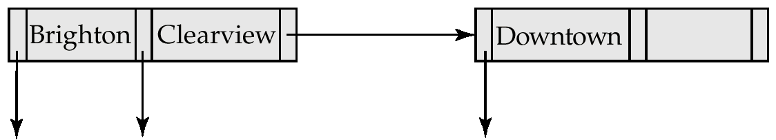
Updates on B⁺-Trees: Insertion (Cont.)
Splitting a node:
  take the n(search-key value, pointer) pairs (including the one being inserted) in sorted order. Place the first ⎡ n/2 ⎤ in the original node, and the rest in a new node.
  let the new node be p, and let k be the least key value in p. Insert (k,p) in the parent of the node being split. If the parent is full, split it and propagate the split further up.
The splitting of nodes proceeds upwards till a node that is not full is found. In the worst case the root node may be split increasing the height of the tree by 1.
Result of splitting node containing Brighton and Downtown on
inserting Clearview

Slide 16

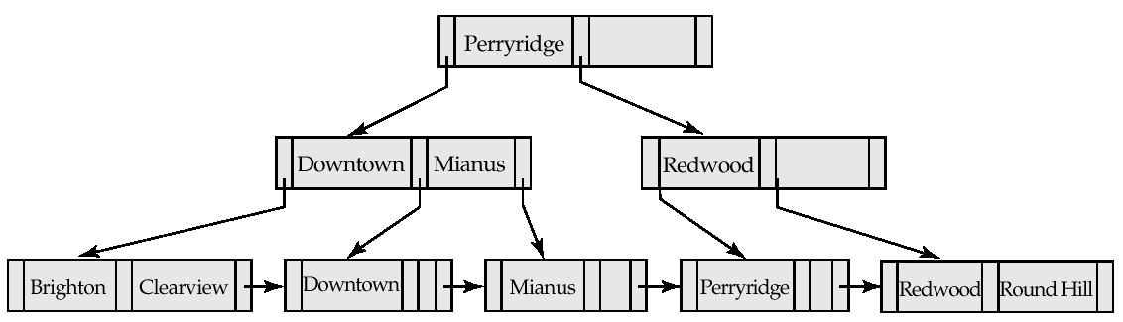
Updates on B⁺-Trees: Insertion (Cont.)
B⁺-Tree before and after insertion of “Clearview”

Slide 17
Deleting a Data Entry from a B+ Tree
Start at root, find leaf L where entry belongs.
Remove the entry.
  If L is at least half-full, done!
  If L less than half-full,
    Try to re-distribute, borrowing from sibling (adjacent node to the right).
    If re-distribution fails, merge L and sibling.
If merge occurred, must delete entry (pointing to L or sibling) from parent of L.
Merge could propagate to root, decreasing height.
Notes:
14

Slide 18
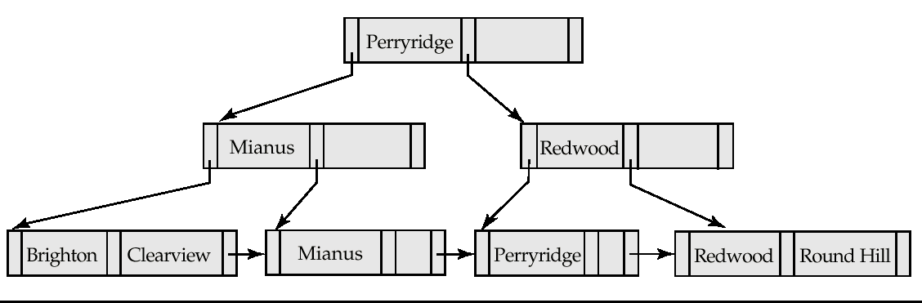
Examples of B⁺-Tree Deletion
Before and after deleting “Downtown”
The removal of the leaf node containing “Downtown” did not result in its parent having too few pointers. So the cascaded deletions stopped with the deleted leaf node’s parent.

Slide 19
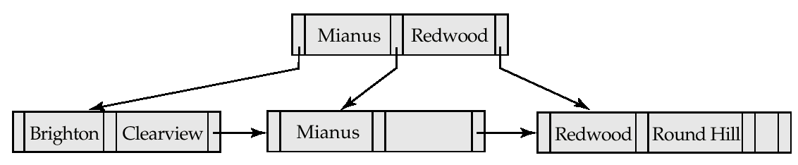
Examples of B⁺-Tree Deletion (Cont.)
Deletion of “Perryridge” from result of previous example
Node with “Perryridge” becomes underfull (actually empty, in this special case) and merged with its sibling.
As a result “Perryridge” node’s parent became underfull, and was merged with its sibling (and an entry was deleted from their parent)
Root node then had only one child, and was deleted and its child became the new root node

Slide 20
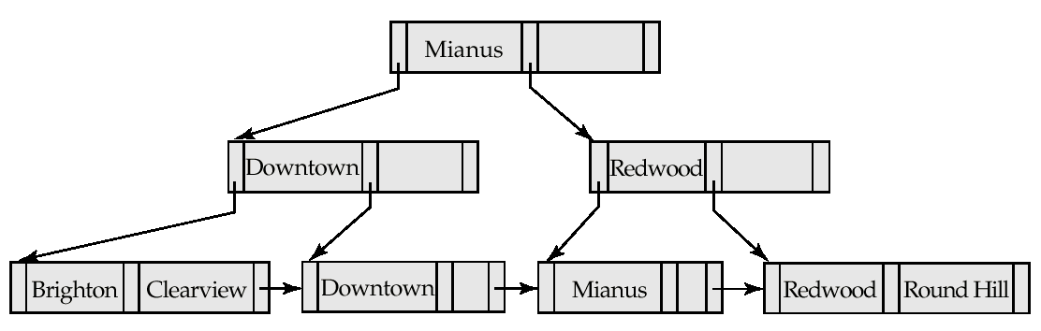
Example of B⁺-tree Deletion (Cont.)
Before and after deletion of “Perryridge” from earlier example
Parent of leaf containing Perryridge became underfull, and borrowed a pointer from its left sibling
Search-key value in the parent’s parent changes as a result

Slide 21
B⁺-Tree File Organization
Index file degradation problem is solved by using B⁺-Tree indices. Data file degradation problem is solved by using B⁺-Tree File Organization.
The leaf nodes in a B⁺-tree file organization store records, instead of pointers.
Since records are larger than pointers, the maximum number of records that can be stored in a leaf node is less than the number of pointers in a nonleaf node.
Leaf nodes are still required to be half full.
Insertion and deletion are handled in the same way as insertion and deletion of entries in a B⁺-tree index.

Slide 22
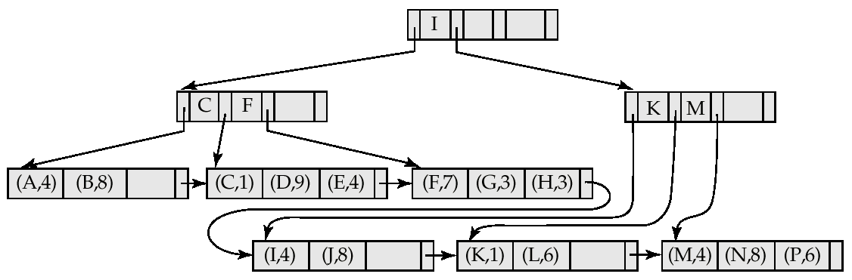

B⁺-Tree File Organization (Cont.)
Example of B⁺-tree File Organization
Good space utilization important since records use more space than pointers.
To improve space utilization, involve more sibling nodes in redistribution during splits and merges
  Involving 2 siblings in redistribution (to avoid split / merge where possible) results in each node having at least entries

Slide 23
Index Definition in SQL
Create an index
  create index <index-name> on <relation-name>
  (<attribute-list>)
  E.g.: create index b-index on branch(branch-name)
Use create unique index to indirectly specify and enforce the condition that the search key is a candidate key.
  Not really required if SQL unique integrity constraint is supported
To drop an index
  drop index <index-name>

Slide 24
Bulk Loading of a B+ Tree
If we have a large collection of records, and we want to create a B+ tree on some field, doing so by repeatedly inserting records is very slow.
Bulk Loading can be done much more efficiently.
Initialization: Sort all data entries (using external sorting – will be discussed in the next class), insert pointer to first (leaf) page in a new (root) page.
Root
Sorted pages of data entries; not yet in B+ tree
3*
4*
6*
9*
10*
11*
12*
13*
20*
22*
23*
31*
35*
36*
38*
41*
44*
Notes:
20

Slide 25
Bulk Loading (Cont.)
Root
10
20
Index entries for leaf pages always entered into right-most index page just above leaf level. When this fills up, it splits. (Split may go up right-most path to the root.)
Much faster than repeated inserts!
Data entry pages
6
12
23
35
not yet in B+ tree
3*
4*
6*
9*
10*
11*
12*
13*
20*
22*
23*
31*
35*
36*
38*
41*
44*
Root
20
10
35
Data entry pages
not yet in B+ tree
6
12
23
38
3*
4*
6*
9*
10*
11*
12*
13*
20*
22*
23*
31*
35*
36*
38*
41*
44*
Notes:
21

Slide 26
Hash Indices
Hashing can be used not only for file organization, but also for index-structure creation.
A hash index organizes the search keys, with their associated record pointers, into a hash file structure.
Strictly speaking, hash indices are always secondary indices
  if the file itself is organized using hashing, a separate primary hash index on it using the same search-key is unnecessary.

Slide 27
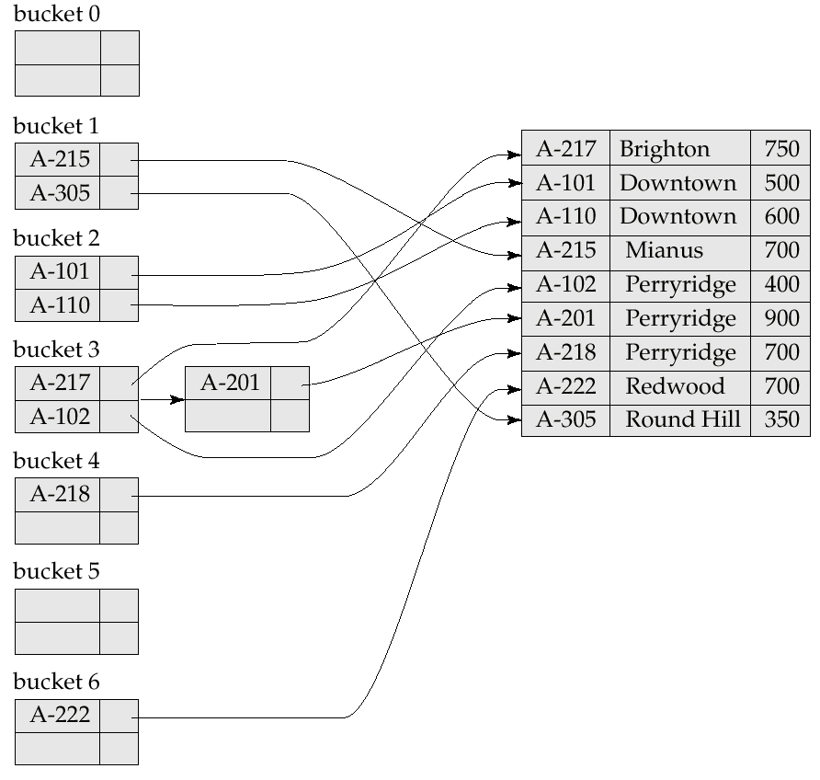
Example of Hash Index

Slide 28
Hash Functions
In the worst case, the hash function maps all search-key values to the same bucket; this makes access time proportional to the number of search-key values in the file.
Ideal hash function is random, so each bucket will have the same number of records assigned to it irrespective of the actual distribution of search-key values in the file.
Typical hash functions perform computation on the internal binary representation of the search-key.
  For example, for a string search-key, the binary representations of all the characters in the string could be added and the sum modulo the number of buckets could be returned.

Slide 29
Handling of Bucket Overflows
Bucket overflow can occur because of
  Insufficient buckets
  Skew in distribution of records. This can occur due to two reasons:
    multiple records have same search-key value
    chosen hash function produces non-uniform distribution of key values
Although the probability of bucket overflow can be reduced, it cannot be eliminated; it is handled by using overflow buckets.
Overflow chaining – the overflow buckets of a given bucket are chained together in a linked list. Long chains degrade performance because a query has to read all buckets in the chain.

Slide 30
Deficiencies of Static Hashing
In static hashing, function h maps search-key values to a fixed set of B of bucket addresses.
  Databases grow with time. If initial number of buckets is too small, performance will degrade due to too much overflows.
  If file size at some point in the future is anticipated and number of buckets allocated accordingly, significant amount of space will be wasted initially.
  If database shrinks, again space will be wasted.
  One option is periodic re-organization of the file with a new hash function, but it is very expensive.
These problems can be avoided by using techniques that allow the number of buckets to be modified dynamically.

Slide 31
Extendible Hashing
Situation: Bucket (primary page) becomes full. Why not re-organize file by doubling # of buckets?
  Reading and writing all pages is expensive!
  Idea: Use directory of pointers to buckets, double # of buckets by doubling the directory, splitting just the bucket that overflowed!
  Directory much smaller than file, so doubling it is much cheaper. Only one page of data entries is split. No overflow page!
  Trick lies in how hash function is adjusted!
Notes:
5

Slide 32
Example
LOCAL DEPTH
2
4*
12*
32*
16*
Bucket A
GLOBAL DEPTH
2
2
00
1*
5*
21*
13*
Bucket B
Directory is array of size 4.
To find bucket for r, take last `global depth’ # bits of h(r); we denote r by h(r).
  If h(r) = 5 = binary 101, it is in bucket pointed to by 01.
01
10
2
10*
Bucket C
11
DIRECTORY
2
15*
7*
19*
Bucket D
DATA PAGES
Insert: If bucket is full, split it (allocate new page, re-distribute).
If necessary, double the directory. (As we will see, splitting a
bucket does not always require doubling; we can tell by
comparing global depth with local depth for the split bucket.)
Notes:
6

Slide 33
Insert h(r)=20 (10100)
LOCAL DEPTH
2
Bucket A
LOCAL DEPTH
3
4*
12*
32*
16*
GLOBAL DEPTH
32*
16*
Bucket A
GLOBAL DEPTH
Bucket B
3
2
2
2
000
1*
5*
21*
13*
Bucket B
00
1*
5*
21*
13*
001
01
010
2
10
2
Bucket C
011
10*
Bucket C
11
10*
100
101
2
Bucket D
110
15*
7*
19*
Bucket D
DIRECTORY
2
111
15*
7*
19*
3
DIRECTORY
4*
12*
20*
Bucket A2
(`split image'
of Bucket A)
Notes:
7

Slide 34
Points to Note
20 = binary 10100. Last 2 bits (00) tell us r belongs in A or A2. Last 3 bits needed to tell which.
  Global depth of directory: Max # of bits needed to tell which bucket an entry belongs to.
  Local depth of a bucket: # of bits used to determine if an entry belongs to this bucket.
When does bucket split cause directory doubling?
  Before insert, local depth of bucket = global depth. Insert causes local depth to become > global depth; directory is doubled by copying it over and `fixing’ pointer to split image page. (Use of least significant bits enables efficient doubling via copying of directory!)
Notes:
8

Slide 35
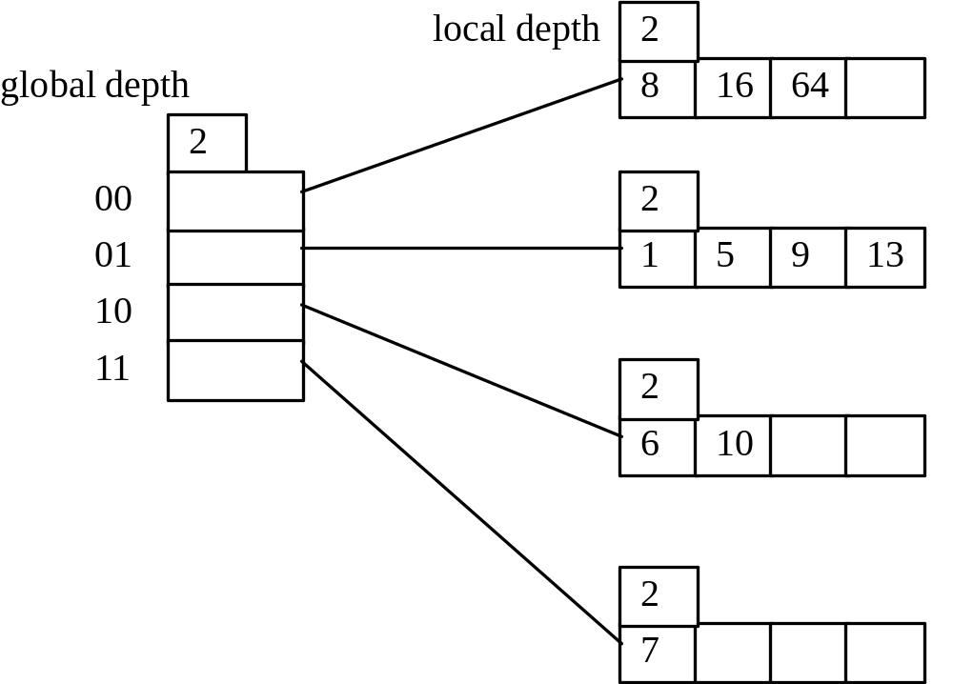
Extendible Hashing Example
Assume the following hash index where the hash function is determined by the least significant bits.
Insert 18 (10010), 32 (100000)

Slide 36
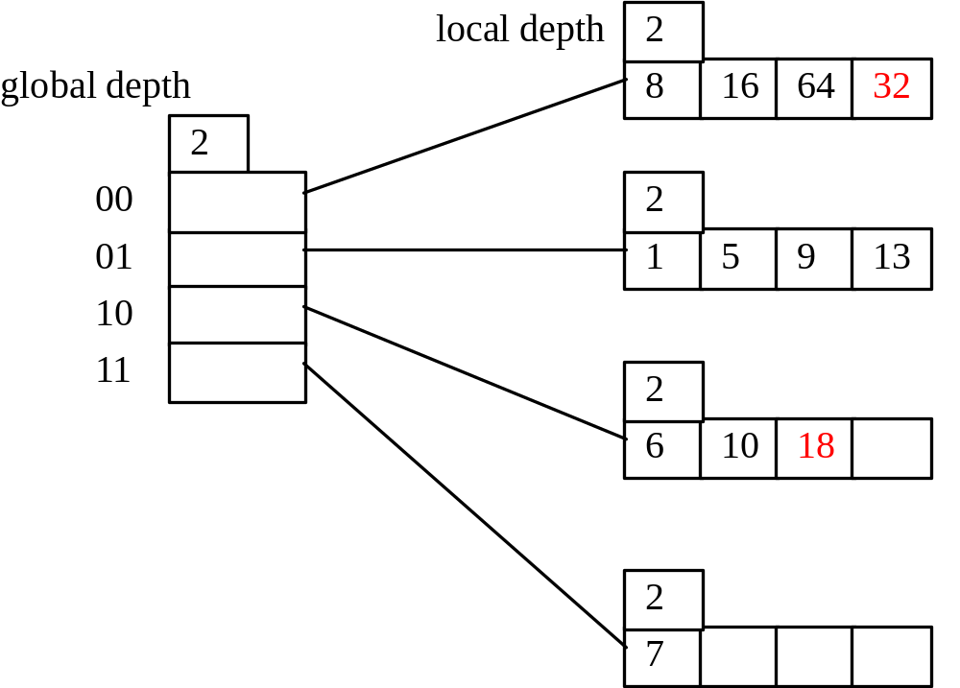
Hashing Example (cont)
After the insertion of records with search keys: 18 (10010), 32 (100000).
Insert: 3 (11), 4 (100)

Slide 37
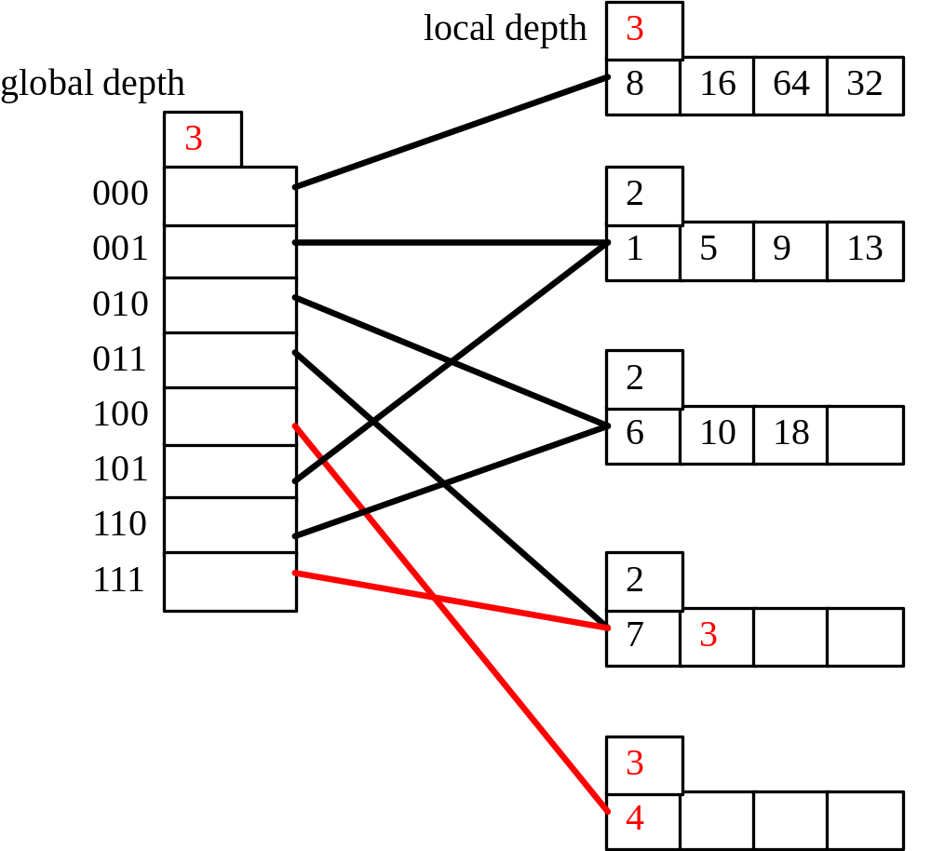
Hashing Example (cont)
After the insertion of records with search keys: 4 (100), 3 (11).
Insert: 19 (10011), 17 (10001)

Slide 38
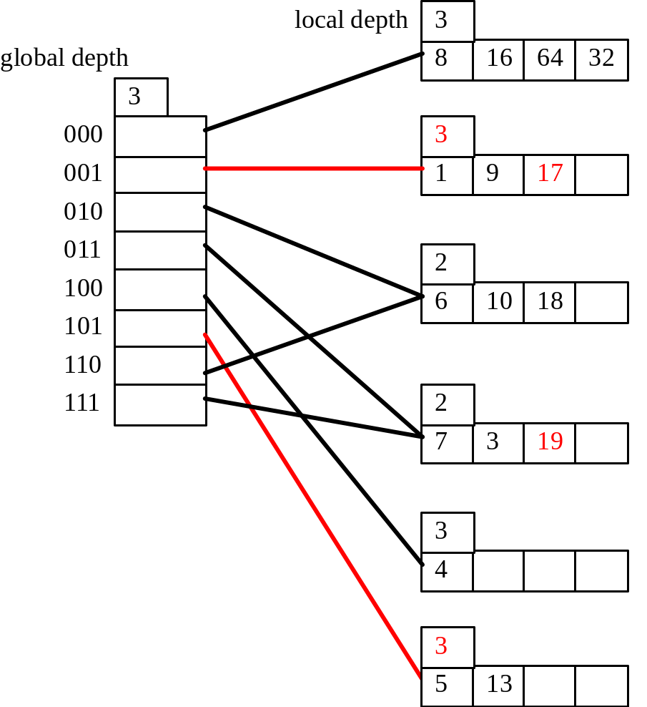
Hashing Example (cont)
After the insertion of records with search keys: 17, 19.
Insert 24 (11000)

Slide 39
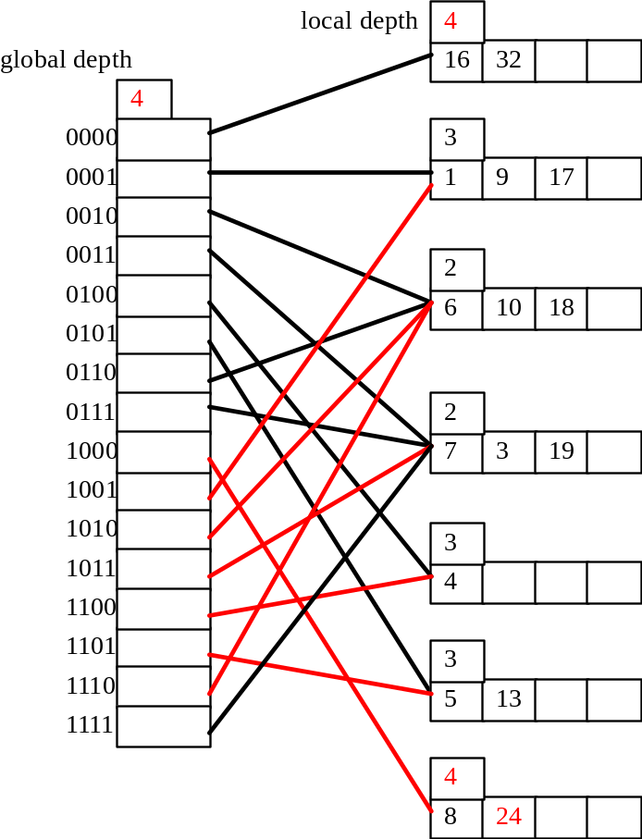
Hashing Example (cont)
After the insertion of record with search key: 24 (11000)

Slide 40
Comments on Extendible Hashing
If directory fits in memory, equality search answered with one disk access; else two.
  100MB file, 100 bytes/rec, 4K pages contains 1,000,000 records (as data entries) and 25,000 directory elements; chances are high that directory will fit in memory.
  Directory grows in spurts, and, if the distribution of hash values is skewed, directory can grow large.
  Multiple entries with same hash value cause problems!
Delete: If removal of data entry makes bucket empty, can be merged with `split image’. If each directory element points to same bucket as its split image, can halve directory.
Notes:
9

Slide 41
Linear Hashing
This is another dynamic hashing scheme, an alternative to Extendible Hashing.
LH handles the problem of long overflow chains without using a directory, and handles duplicates.
Idea: Use a family of hash functions h₀, h₁, h₂, ...
  h_{i}(key) = h(key) mod(2^{i}N); N = initial # buckets
  h is some hash function (range is not 0 to N-1)
  If N = 2^{d0}, for some d0, h_{i} consists of applying h and looking at the last di bits, where di = d0 + i.
  h_{i+1} doubles the range of h_{i} (similar to directory doubling)
Notes:
10

Slide 42
Linear Hashing (Contd.)
Directory avoided in LH by using overflow pages, and choosing bucket to split round-robin.
  Splitting proceeds in `rounds’. Round ends when all N_{R} initial (for round R) buckets are split. Buckets 0 to Next-1 have been split; Next to N_{R} yet to be split.
  Current round number is Level.
  Search: To find bucket for data entry r, find h_{Level}(r):
    If h_{Level}(r) in range `Next to N_{R}’ , r belongs here.
    Else, r could belong to bucket h_{Level}(r) or bucket h_{Level}(r) + N_{R}; must apply h_{Level+1}(r) to find out.
Notes:
11

Slide 43
Overview of LH File
In the middle of a round.
Buckets split in this round:
Bucket to be split
If
h
(
search key value
Level
)
Next
is in this range, must use
h
(
search key value
Level+1
)
Buckets that existed at the
to decide if entry is in
beginning of this round:
`split image' bucket.
this is the range of
h
Level
`split image' buckets:
created (through splitting
of other buckets) in this round
Notes:
11

Slide 44
Example of Linear Hashing
insert 43 (101011)
insert 37(..101),
insert 29 (..101)
On split, h_{Level+1} is used to re-distribute entries.
Level=0, N=4
Level=0
h
h
PRIMARY
h
h
PRIMARY
OVERFLOW
1
0
Next=0
PAGES
1
0
PAGES
PAGES
000
00
32*
44*
36*
000
00
32*
Next=1
9*
25*
5*
Data entry r
9*
25*
5*
37*
001
01
with h(r)=5
001
01
010
10
14*
18*
10*
30*
Primary
010
10
14*
18*
10*
30*
insert
h(r)=43
bucket page
011
31*
35*
7*
11*
011
31*
35*
7*
11*
43*
11
11
(This info
is for illustration
only!)
(The actual contents
of the linear hashed
file)
100
00
44*
36*
Notes:
13

Slide 45
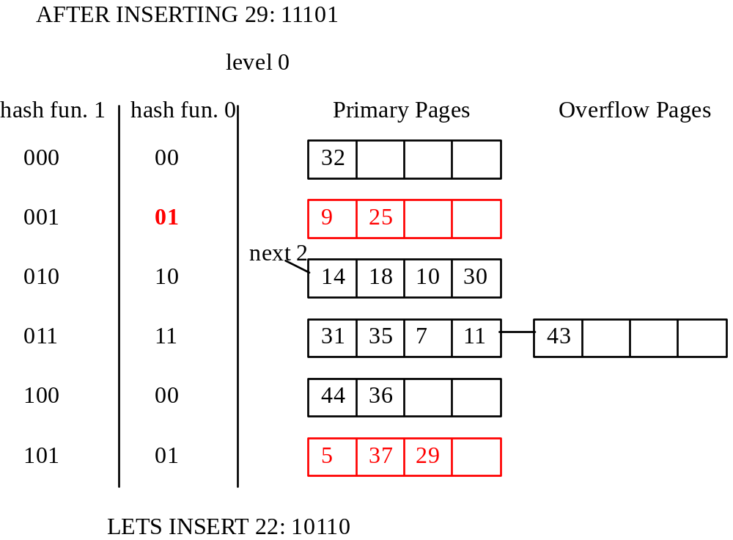
Example of Linear Hashing (cont)

Slide 46
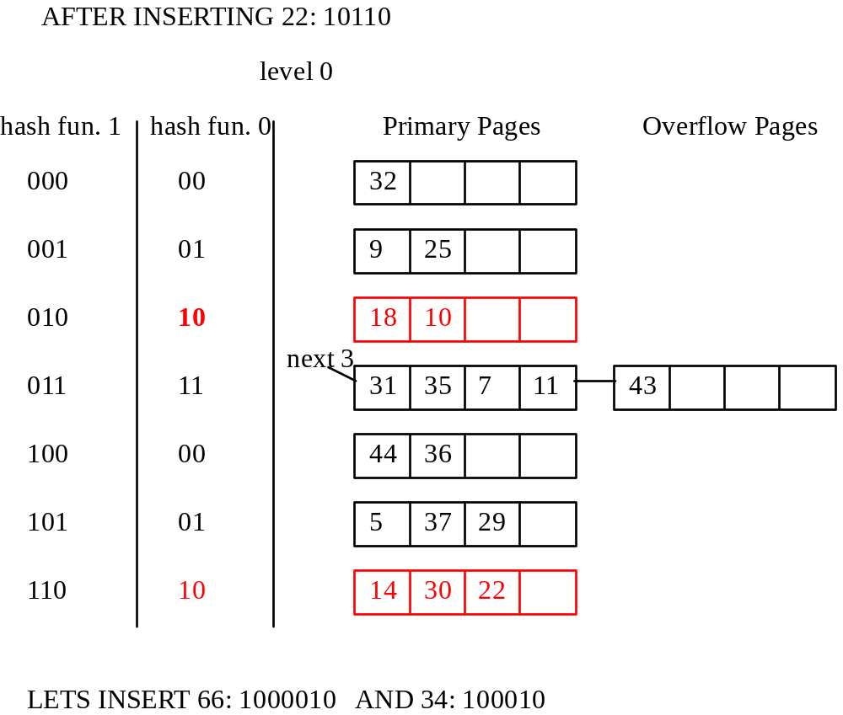
Example of Linear Hashing (cont)

Slide 47
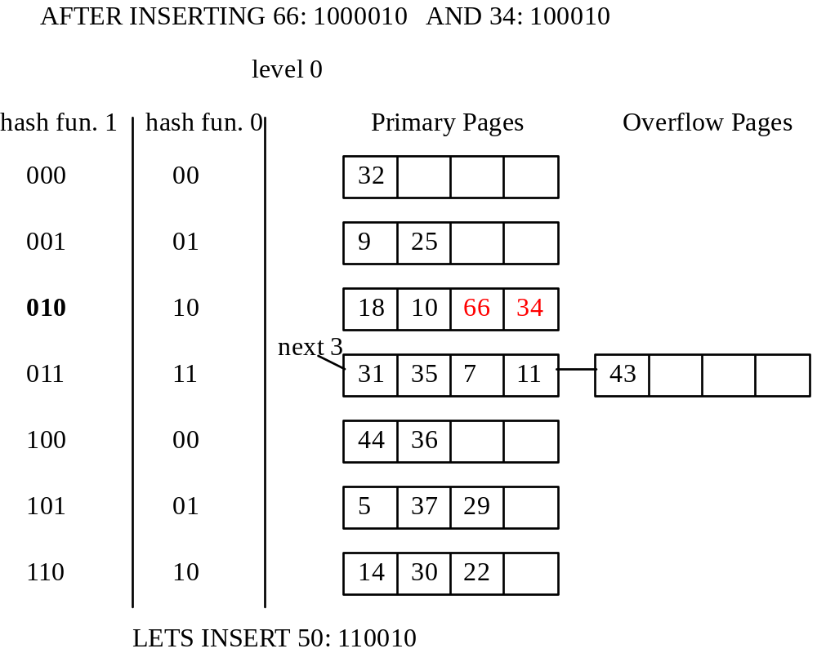
Example of Linear Hashing (cont)

Slide 48
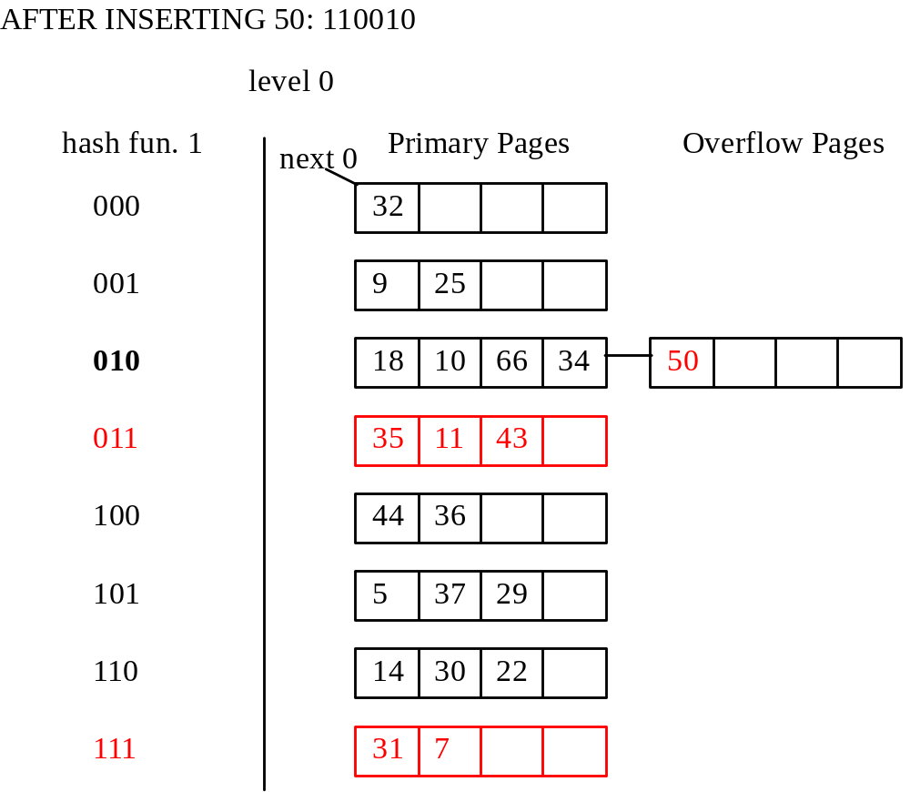
Example of Linear Hashing (cont)

